Slide 1
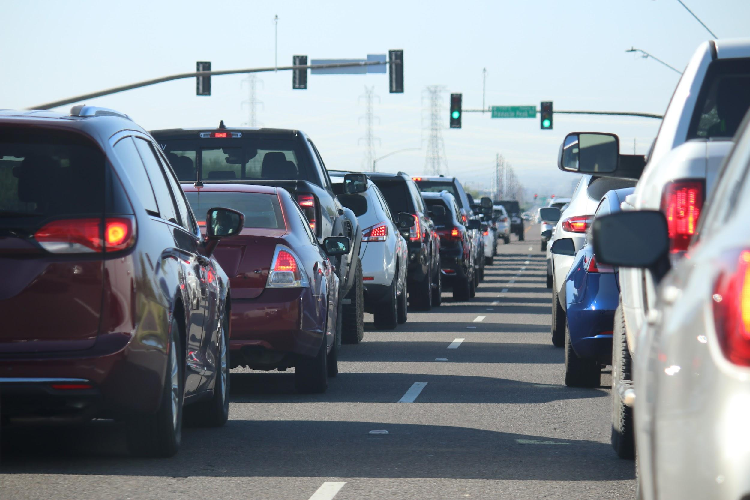
Exploratory Data Analysis on United States Accidents
Kefalas Nikolaos

Slide 2
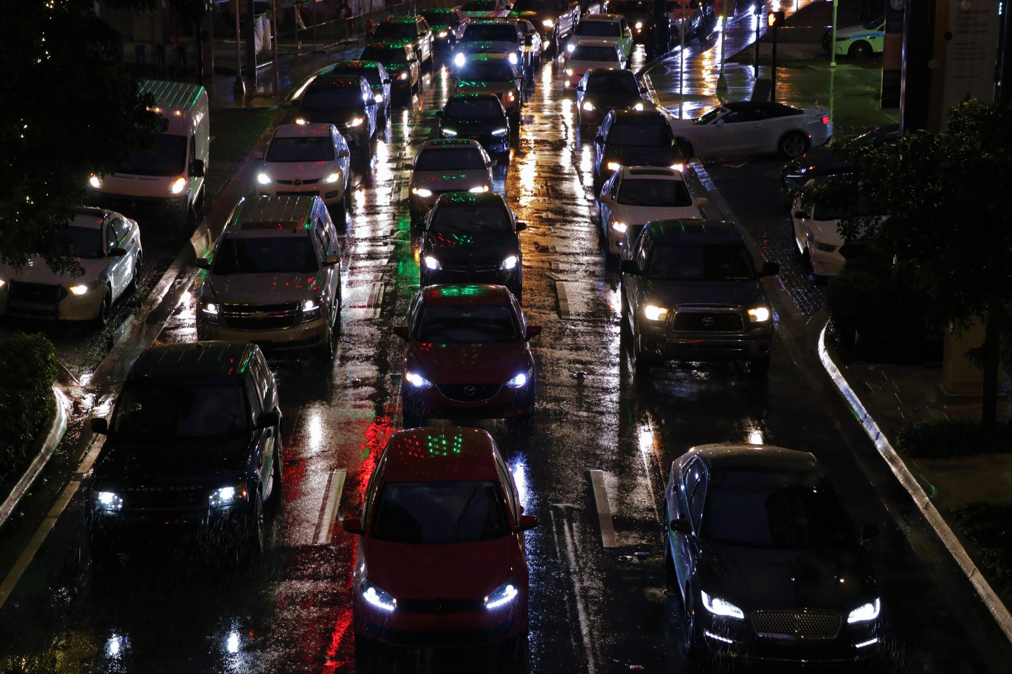
The Problem
Stakeholders
Which environmental factors affect the car accidents and how?
Are there any patterns related to car accidents?
US Department of Transportation
Insurance Carriers
Drivers

Slide 3
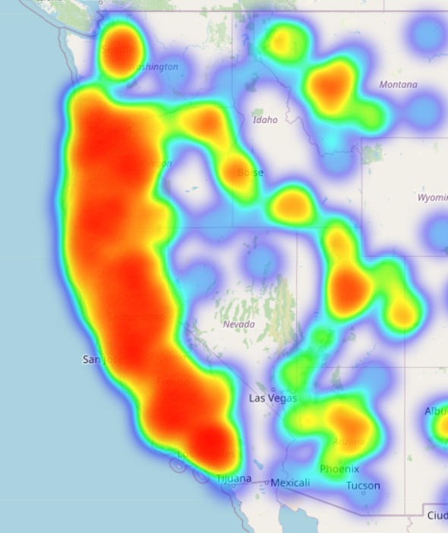
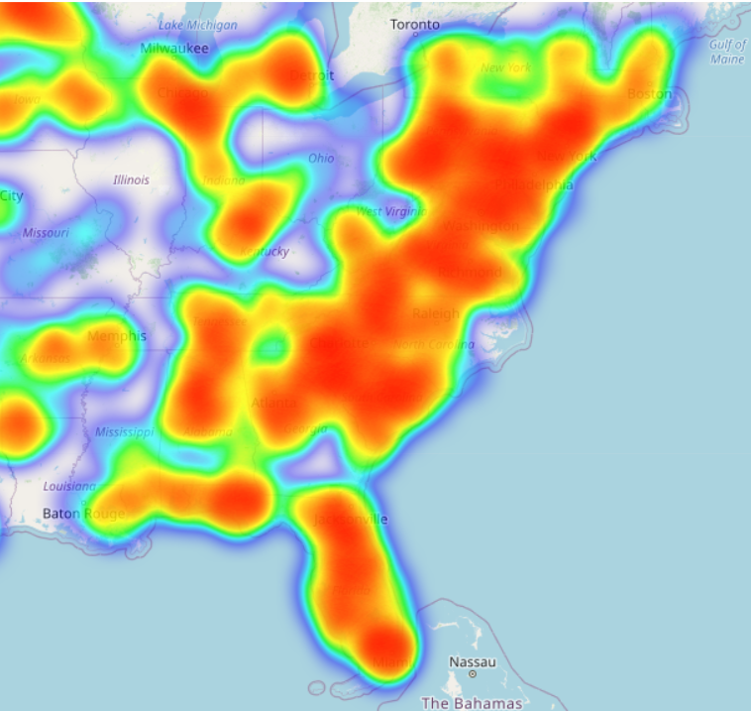
Areas with the most car accidents

Slide 4
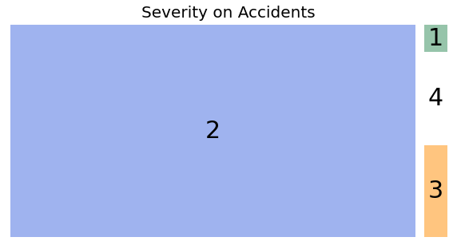
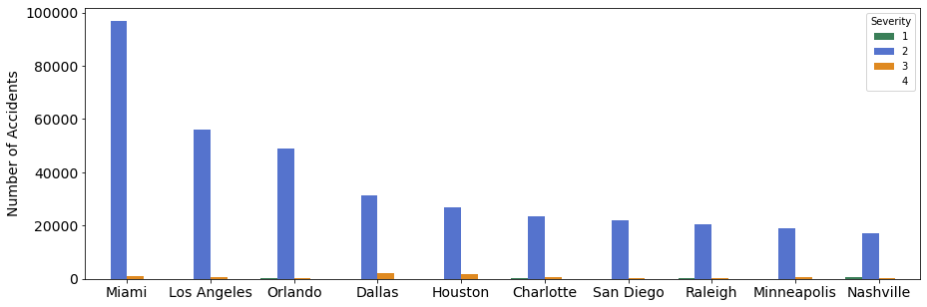
Top 20 cities based on car accidents from 2016-2021

Slide 5
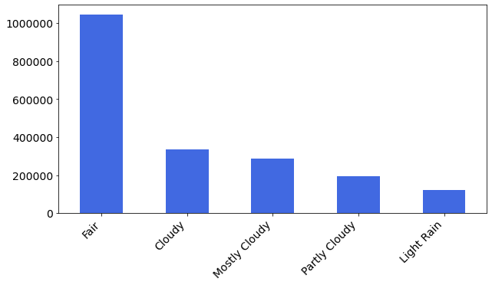
Top weather conditions in which car accidents occured
There are 115 weather conditions in total but most of theme with a few records

Slide 6
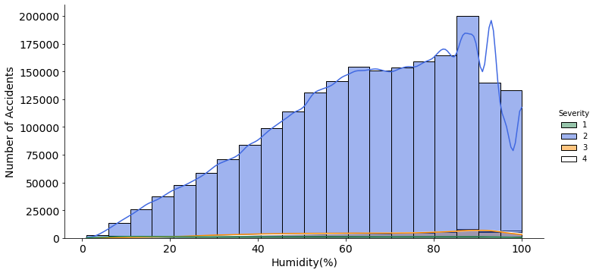
Environmental Factor : Humidity
The humidity levels do not affect the Severity of the accidents but most of them have a Severity of 2.

Slide 7
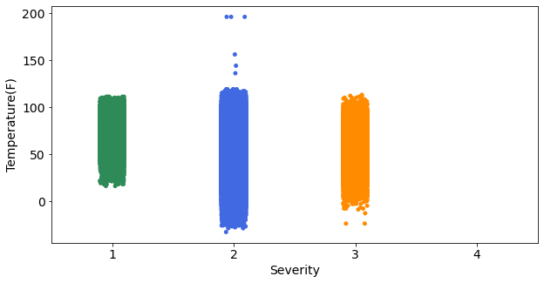
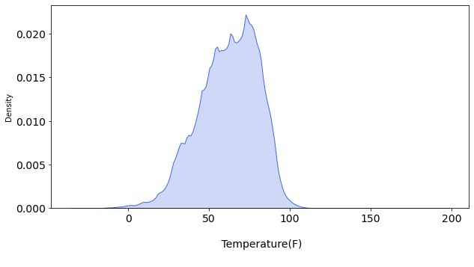
Environmental Factor : Temperature
Temperature shows a normal distribution across the dataset but as the Temperature drops, the Severity increases.

Slide 8
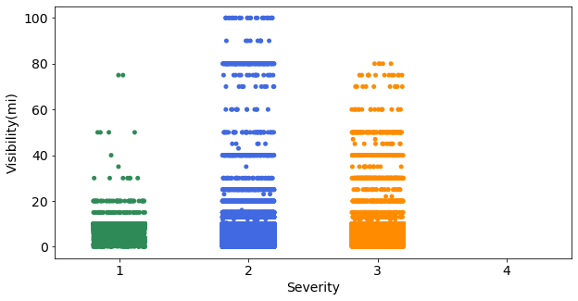
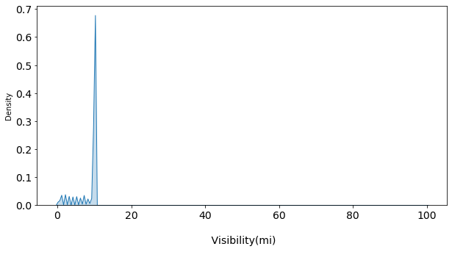
Environmental Factor : Visibility
Visibility has a negative skew. Low visibility affects the number of accidents significantly. Higher Visibility led to higher Severity.

Slide 9
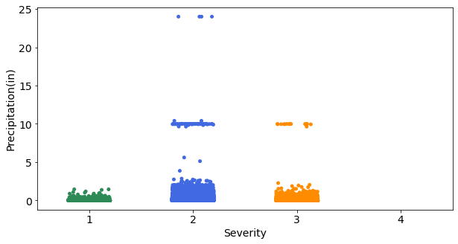
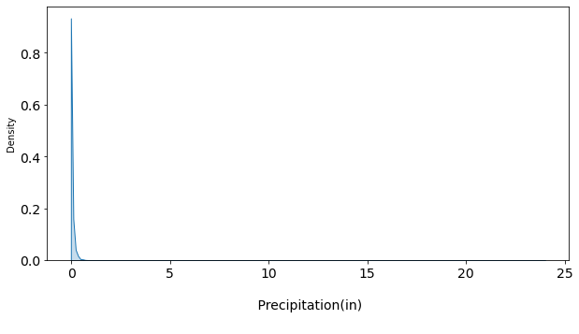
Environmental Factor : Precipitation
Precipitation has a negative skew. Higher Precipitation does not cause more accidents but increases the Severity.

Slide 10
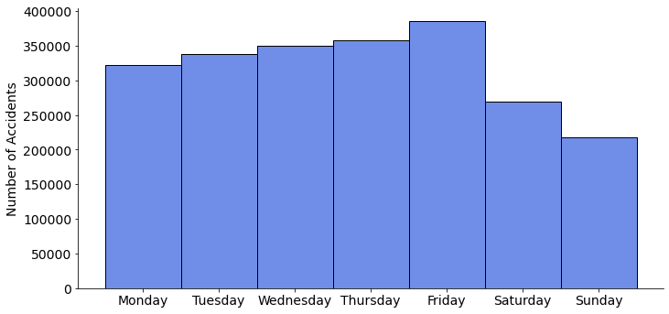
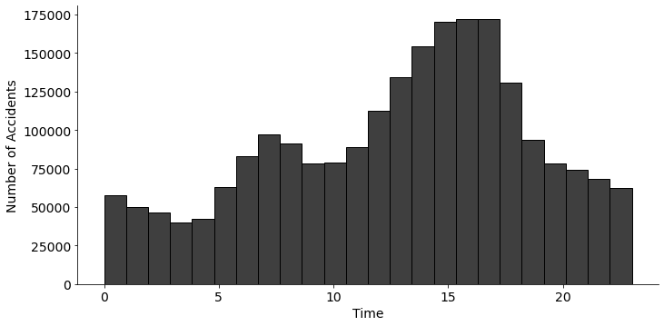
Time And Day Analysis : Weeks
There are less accidents on the weekends. Most accidents occur between 15:00-18:00 and 06:00-08:00.

Slide 11
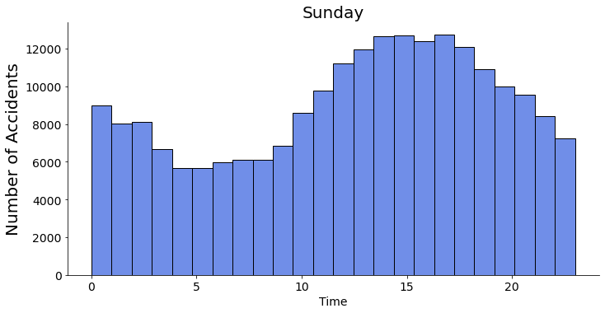
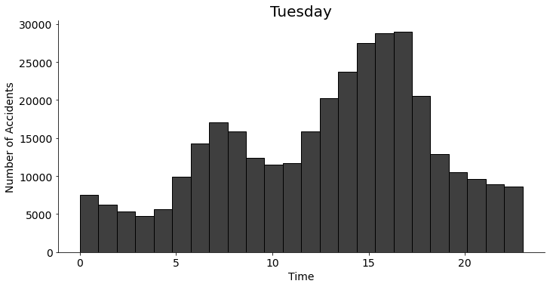
Time And Day Analysis : Days
Tuesday has the same time pattern with the overall time pattern. On weekends there are more accidents at 00:00 than on weekdays.

Slide 12
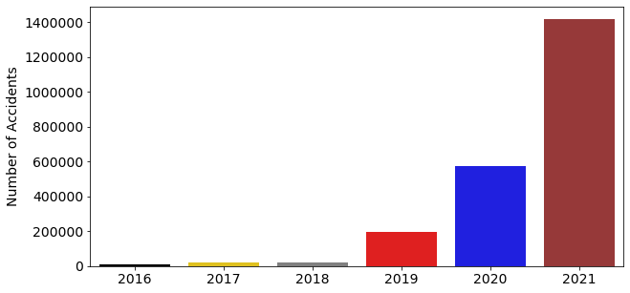
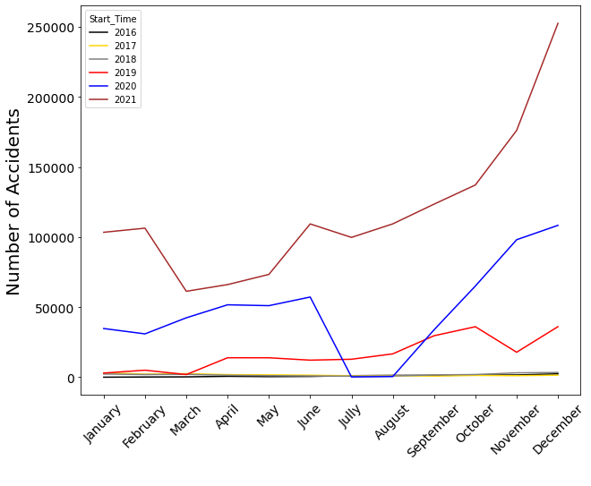
Time And Day Analysis : Years-Months
Every year the number of accidents increases. There was a big drop in 2020 from June until August.

Slide 13
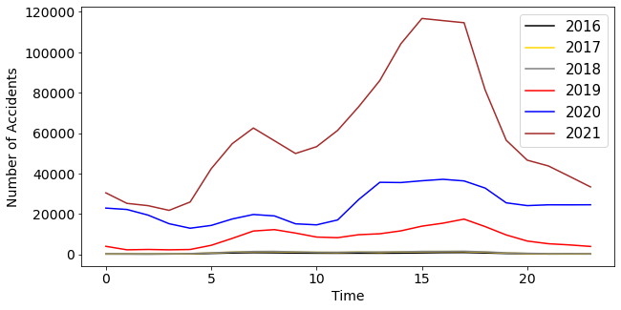
Time And Day Analysis : Years-Time

Slide 14
Dataset from :https://www.kaggle.com/datasets/sobhanmoosavi/us-accidents
Credits: Moosavi, Sobhan, Mohammad Hossein Samavatian, Srinivasan Parthasarathy, and Rajiv Ramnath. “A Countrywide Traffic Accident Dataset.”, 2019.
Thank You!

